Slide 1
Multi-stakeholder co-operation on diabetes prevention in Hungary
Mihály Kökény, MD, PhD
University of Debrecen, Faculty of Public Health, Debrecen, Hungary
The Graduate Institute, Global Health Centre, Geneva, Switzerland
Hungarian Association of Lions Clubs
mihaly.kokeny88@gmail.com
IDF Europe-Feel4Diabetes Dissemination Meeting
Brussels, 24 September 2018

Slide 2
Alarming data
772 000 diabetic patients live in Hungary (8% of the population), of which 94% has type 2 (727 000), 6% has type 1 diabetes (45 000 people).
At least another 8% does not know he/she is diabetic. It means that the prevalence estimate is around 15%
For type 2, a 71% increase was observed over a decade and a half. Over 60, every fifth is diabetic.
As regards risk factors: 65% of the adult population is overweight or obese (the body mass index is above 25 kg /nm). Every fourth Hungarian child is overweight.
Annually, 3600 patients had lower limb amputations due to complications of diabetes, 10 amps per day.
32 000 diabetic patients are blind or severely visually impaired. An additional 1000 patients per year lose vision due to diabetes.
The health insurance spends 220-230 billion HUF (approx. 0.7 billion euro) per year for diabetes care.

Slide 3
Too many people are admitted to hospitals for diabetes, highlighting the need to improve primary care Diabetes hospital admission in adults, 2006 and 2011 (or nearest year)

Slide 4
Snapshot on healthcare in HUN
Over-centralized and underfunded public system
Total health expenditures are around 7% of GDP, while the EU28 average is close to 10% (private spending is above 35%, one of the highest in the EU)
Considerable health workforce shortage: since 2005 approx. 7000 doctors (many nurses) have emigrated because of law salaries, poor working conditions, overload and lack of vision – led to longer waiting lists, deterioration of quality
Aging GPs have no incentives and time for prevention of NCDs
In the last 10 years governments have not put health and healthcare on their priority list

Slide 5
Diabetes care in HUN
Early diagnosis, treatment and care should be managed by general practitioners; specialists provide consultative support
The Hungarian Diabetes Association (HDA) has a pro-active role in training, research, even in licencing specialists for diabetes (currently around 500) and accrediting diabetes care units
HDA initiated and elaborated national diabetes control programs (1991, 2006, 2011) but none of them has been endorsed
Challenges:
Weak health literacy (in terms of promoting physical exercise and balanced nutrition)
Lack of governance for health (multisectoral approach)
Diabetic food is expensive and not always available
Survival of paternalistic attitudes in healthcare
Overburden of health personnel: no time for personalized advices
Access to innovative drugs is limited
Cooperation among various medical sub-disciplines is missing

Slide 6
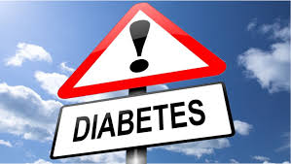
Goals of Lions Clubs International (LCI) – a global charity organization covering 206 countries with 1,5 million members
Diabetes is one of the 5 areas of focus. Others include starvation, environment, vision and childhood cancer.
In the context of diabetes LCI aims at:
Educate Lions and Lions’ communities.
Create environments that inspire and support healthy lifestyles.
Increase access to diabetes care, medication and diagnostic equipment.
Help implement national diabetes policies and plans.

Slide 7
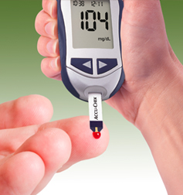
Hungarian Lions against diabetes in partnership with medical students and patient organizations
Blood sugar measurement and overall risk assessment – together with eye screening - in disadvantaged groups (impoverished villages, old-age homes, Roma settlements)
Health education and information campaigns in schools for healthy living
Charity events to finance the diabetes prevention and care , such as supporting local diabetes clubs, summer camps for diabetic children, purchasing new equipments, etc.

Slide 8
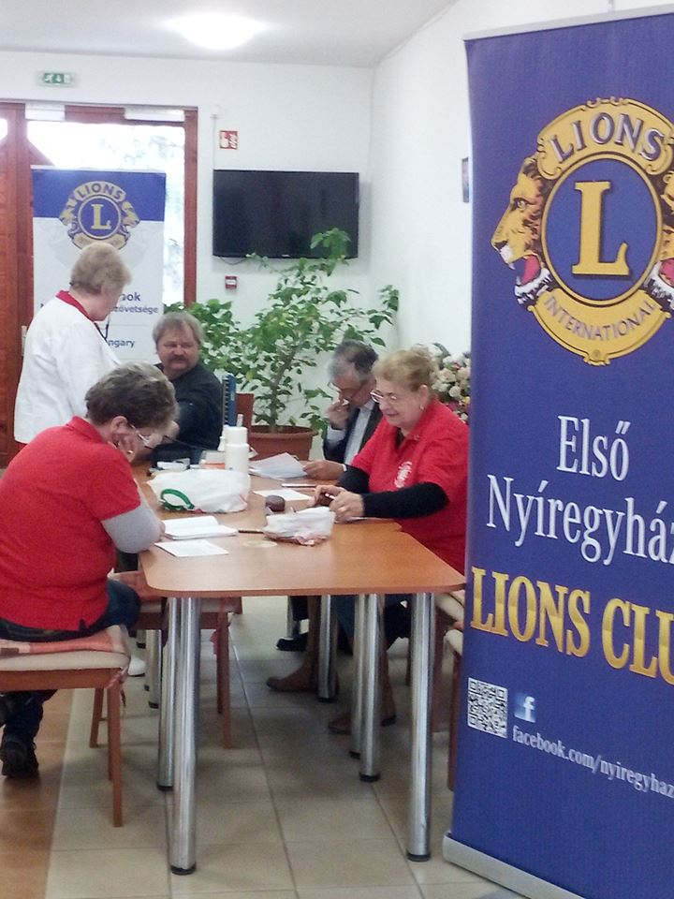
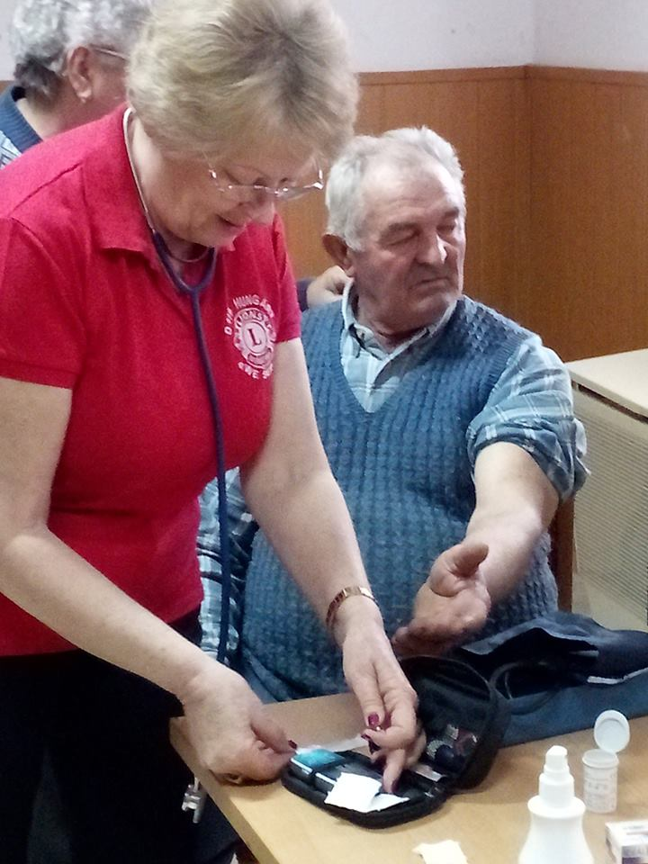
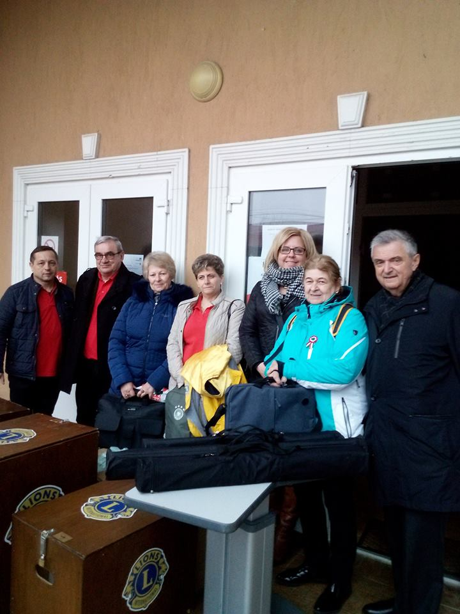
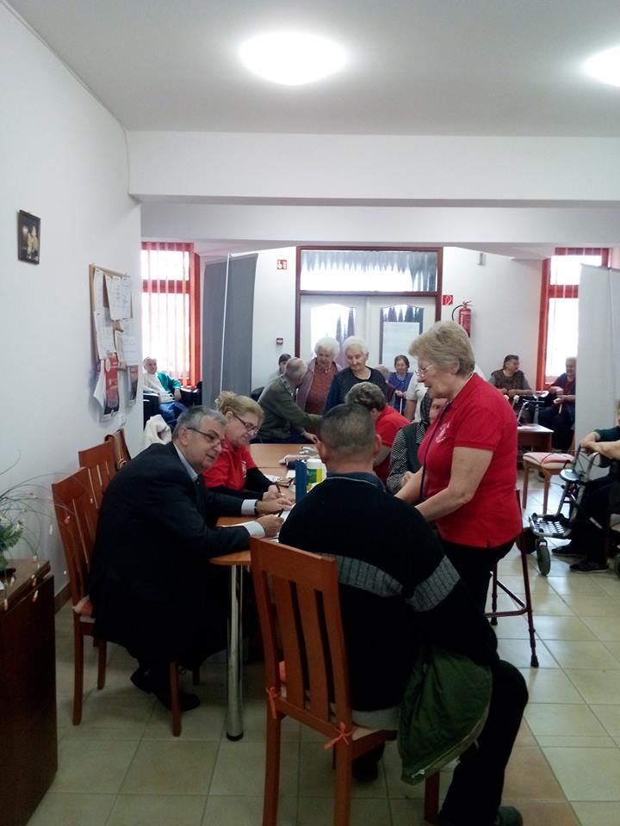
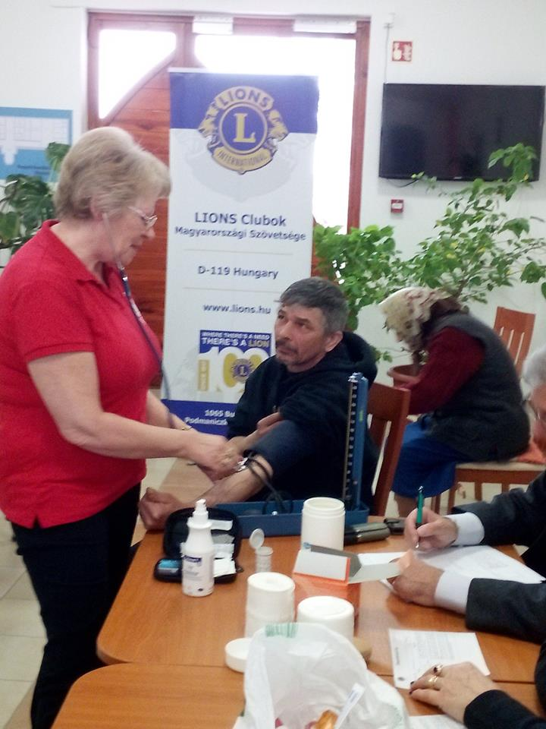

Slide 9
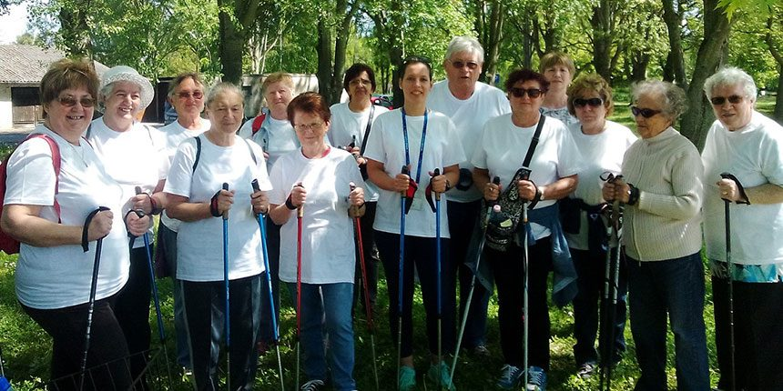
Fields of cooperation between Lions and Association of Diabetic Patient Organizations
Joint educational events in secondary schools
Nordic walking with diabetics
National survey to explore the existing pathways of patients within the health system, the insufficiencies of care and the expectations of patients

Slide 10
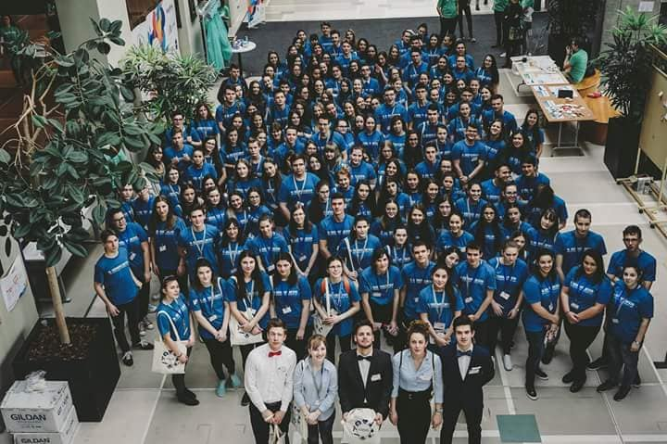
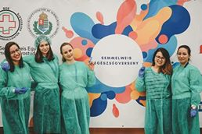
Working together with medical students
Just one example:
Budapest Medical Student Association organizes multi-round health competition for 14-18 years students each year.
Topics cover chronic diseases incl. diabetes.
In 2018: 1765 students participated.
Lions as patrons provide sponsors and prizes.

Slide 11
Conclusion
Healthcare systems cannot cope with the emerging epidemic of diabetes in most of the countries including Hungary
Coordinated efforts of NGOs may narrow the gap stretching between needs and opportunities
Performance of civic society organizations should be closely evaluated and consulted with public health authorities

